Slide 1
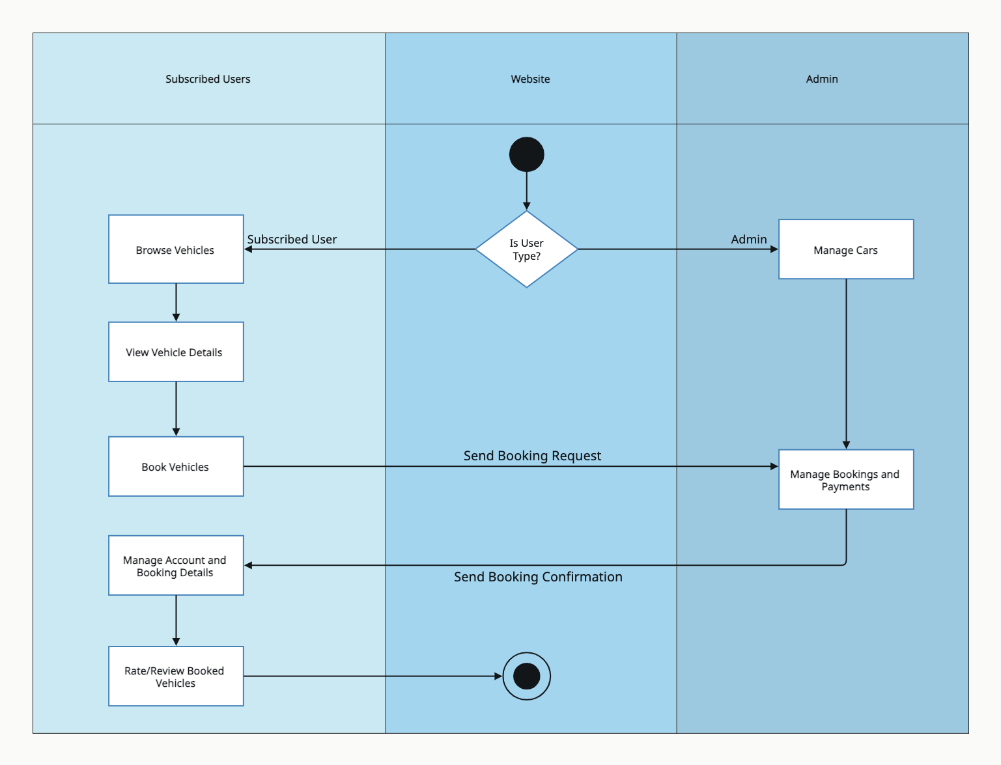
EzCars
Activity Diagram

